Slide 1

BMS INSTITUTE OF TECHNOLOGY AND MANAGEMENT Yelahanka, Bengaluru – 560064 DEPARTMENT OF TELECOMMUNICATION ENGINEERING
Course code -18EC741
IOT AND WIRELESS SENSORS NETWORK
HEALTHCARE MONITORING SYSTEM
Submitted to
Dr.Banuprakash R
Asst professor ,dept of ETE
BMSIT&M
Presented by
MANUSHREE N [1BY18TE031]
SUBHIKSHA AP [1BY18TE059]
WADHWA SIMRAN DEEPAK[1BY18TE062]
NAGAVENI [1BY19TE402]

Slide 2
TABLE OF CONTENTS
Introduction
Implementation
Demonstration
Future Advancements
Conclusion
References

Slide 3
INTRODUCTION
Temperature monitoring system acts useful when during severe conditions, where the patient can be monitored all the way to hospital.
Patients who have to be monitored for a long period of term which causes a nurse to be expensive, and can adopt a temperature monitoring system.
The module helps patients who live in distant areas which lack a hospital facility.

Slide 4
DEMONSTRATION

Slide 5
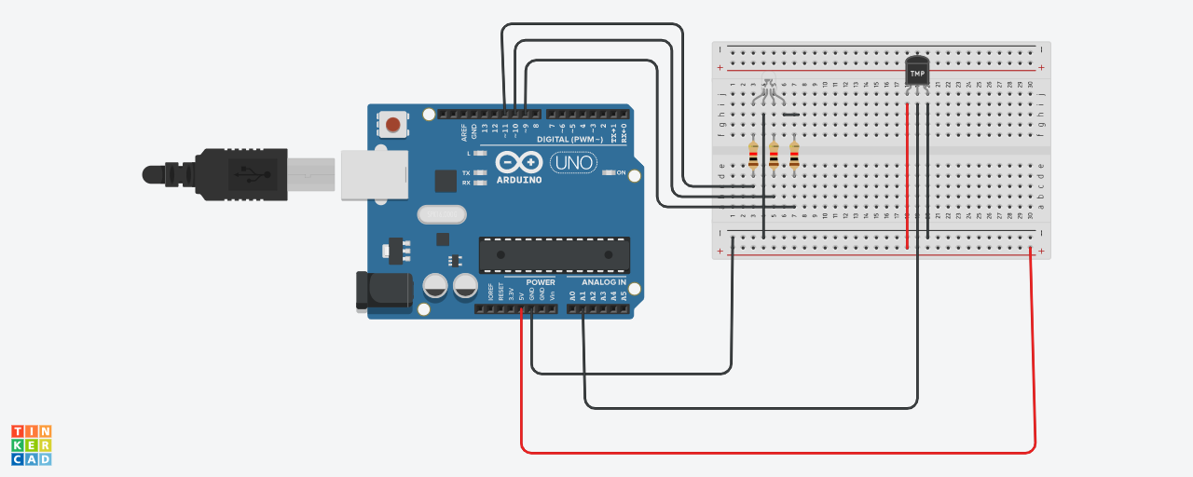

Slide 6
FUTURE ADVANCEMENTS
The healthcare market is one of the major in which there is a huge growth.
Everyone can afford a temperature monitoring system or a wearable band which keeps them in regular update with body fitness.
The bands can cover blood pressure, body temperature, heartbeat and more advancements can be made which leads to a major growth in healthcare.
The future of the healthcare industry is more reliable on health monitoring systems and temperature monitoring systems for consumer safety and reliability.

Slide 7
CONCLUSION
The use of standard microcontroller used and with right peripherals we can make a temperature monitoring system affordable to people.
A band which can be used by patients, fire fighters, and others which can be monitored by the physician and gets a warning notification incase of an emergency and can be immediately considered to resolve.
With a temperature monitoring system, you can easily track, control, and regulate the patients temperature in a specific environment and can be useful in sever conditions.

Slide 8
References
Ramesh, V., M. Sankaramahalingam, MS Divya Bharathy, and R4 Aksha. "Remote temperature monitoring and control using IoT." In 2017 International Conference on Computing Methodologies and Communication (ICCMC), pp. 1059-1063. IEEE, 2017.
Kodali, Ravi Kishore, Govinda Swamy, and Boppana Lakshmi. "An implementation of IoT for healthcare." In 2015 IEEE Recent Advances in Intelligent Computational Systems (RAICS), pp. 411-416. IEEE, 2015.
Gondalia, Aashay, Dhruv Dixit, Shubham Parashar, Vijayanand Raghava, Animesh Sengupta, and Vergin Raja Sarobin. "IoT-based temperature monitoring system for war soldiers using machine learning." Procedia computer science 133 (2018): 1005-1013.
Lakshmi, G. Jaya, Mangesh Ghonge, and Ahmed J. Obaid. "Cloud based iot smart temperature system for remote patient monitoring." EAI Endorsed Transactions on Pervasive Health and Technology (2021): e4.
Anan, Safayat Reza, Md Hossain, Md Milky, Mohammad Monirujjaman Khan, Mehedi Masud, and Sultan Aljahdali. "Research and Development of an IoT-Based Remote Asthma Patient Monitoring System." Journal of Healthcare Engineering 2021 (2021).

Slide 9
THANK YOU

